Slide 1


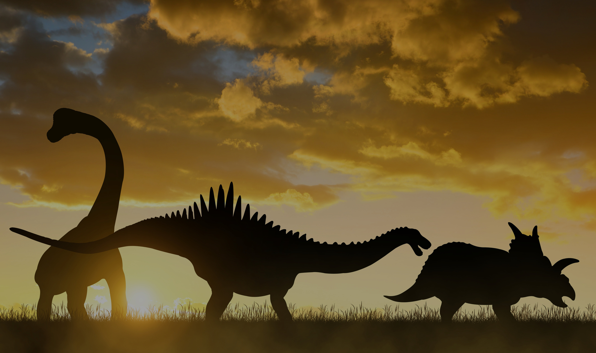
THOMAS MORE
Dinosaur Image Classification Challenge
Deep Learning Project
TEAM MEMBERS:
Zeeshan Mehmood
Muhammad Zubair
Ehtisham Shafique

Slide 2


Challenge Overview
Classify images into 7 dinosaur species
Model Development using TensorFlow/Keras
Exploratory Data Analysis (EDA)
Data Augmentation
Custom CNN Model
Transfer Learning
Training Visualization
Model Evaluation
Fine Tune Models
Kaggel Submission

Slide 3
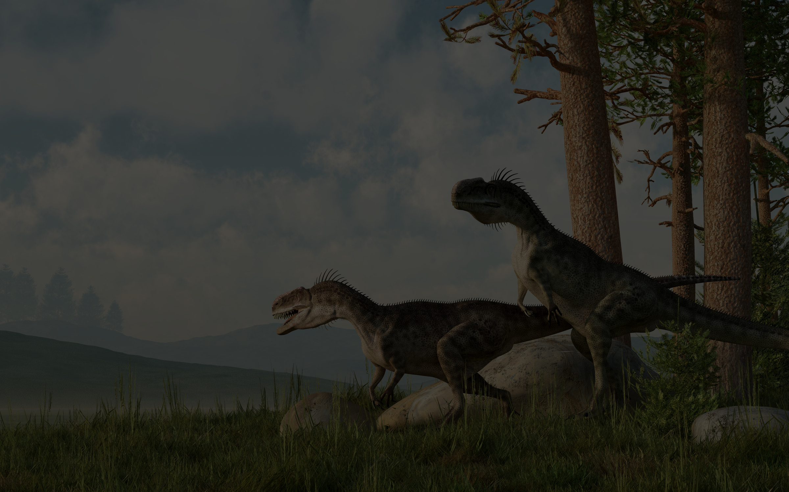

Confguration
Import all required Libraries
Batch Size =32
Image Resolution 224 x 224
Seed = 123
Epoch = 20
TRAIN_DIR = 'train'
TEST_DIR = 'test'`

Slide 4
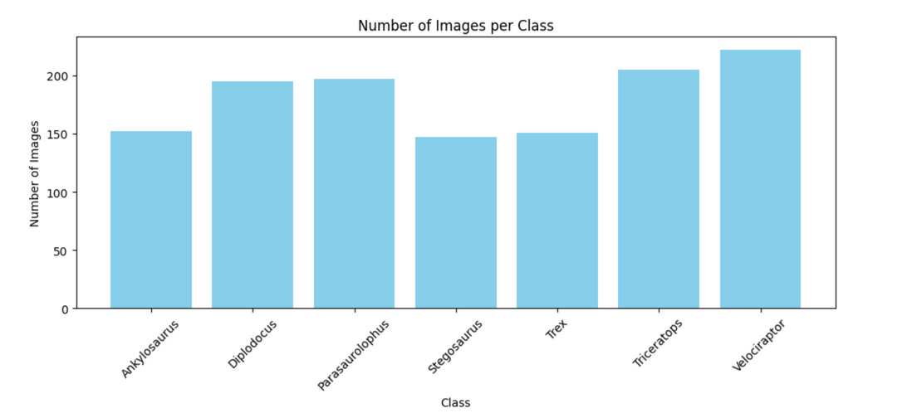
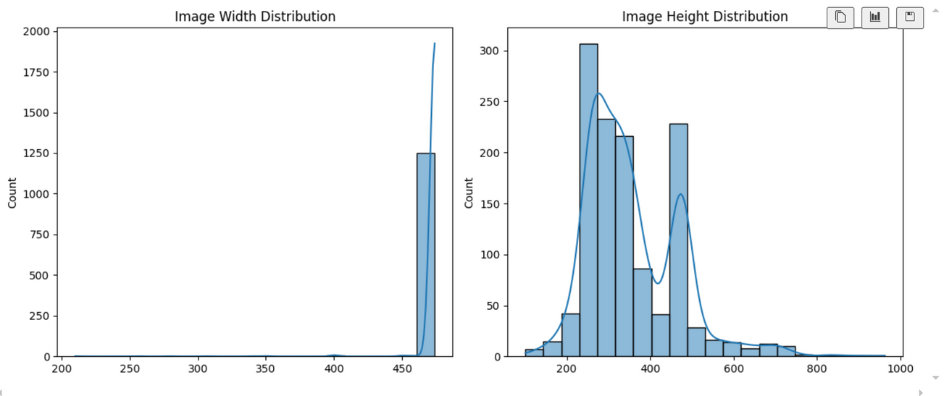
Exploratory Data Analysis (EDA)
Image Distribution per Class
Images Resolution
The dataset is moderately balanced
Not a severe imbalance
59 low resolution images converted to high resolution images
All images have same .jpg extension

Slide 5
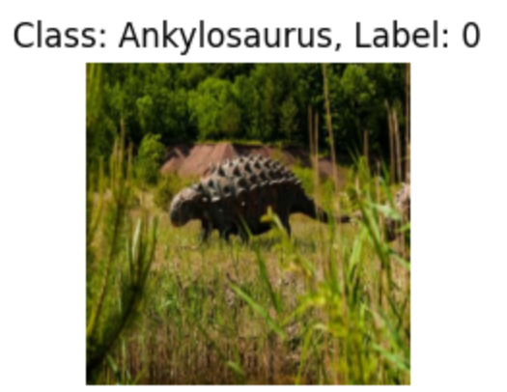
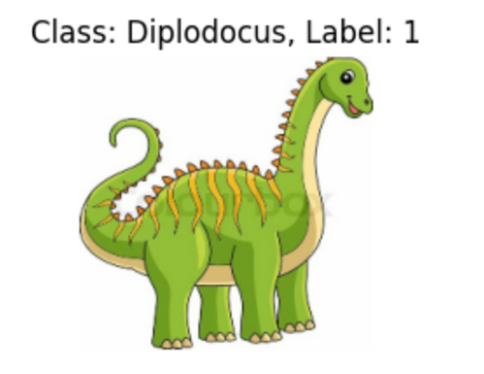
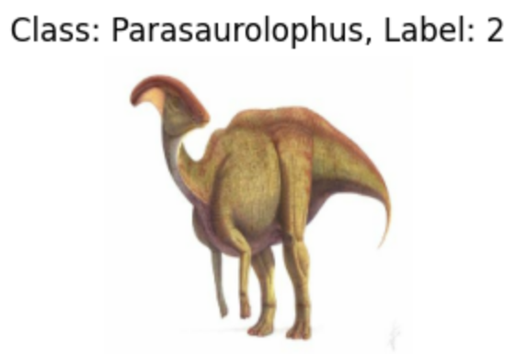
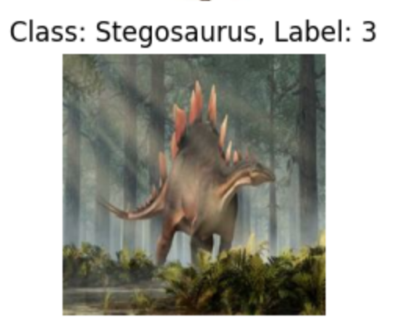
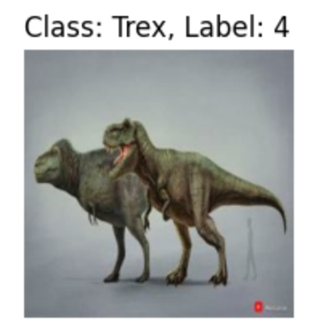
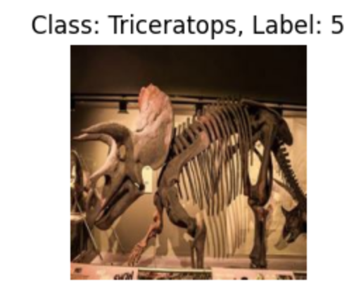
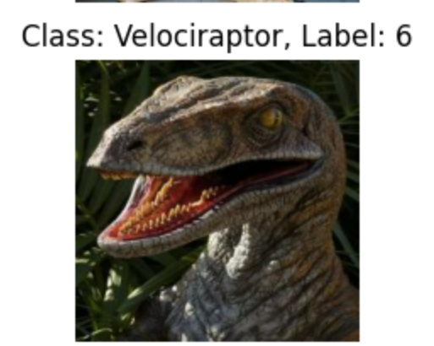
Exploratory Data Analysis (EDA)
Sample images with class label

Slide 6

Data Augmentation
Applied during training to prevent overfitting and generalization
layers.RandomFlip("horizontal"),
layers.RandomRotation(0.1),
layers.RandomZoom(0.1),
layers.RandomTranslation(0.1, 0.1)

Slide 7
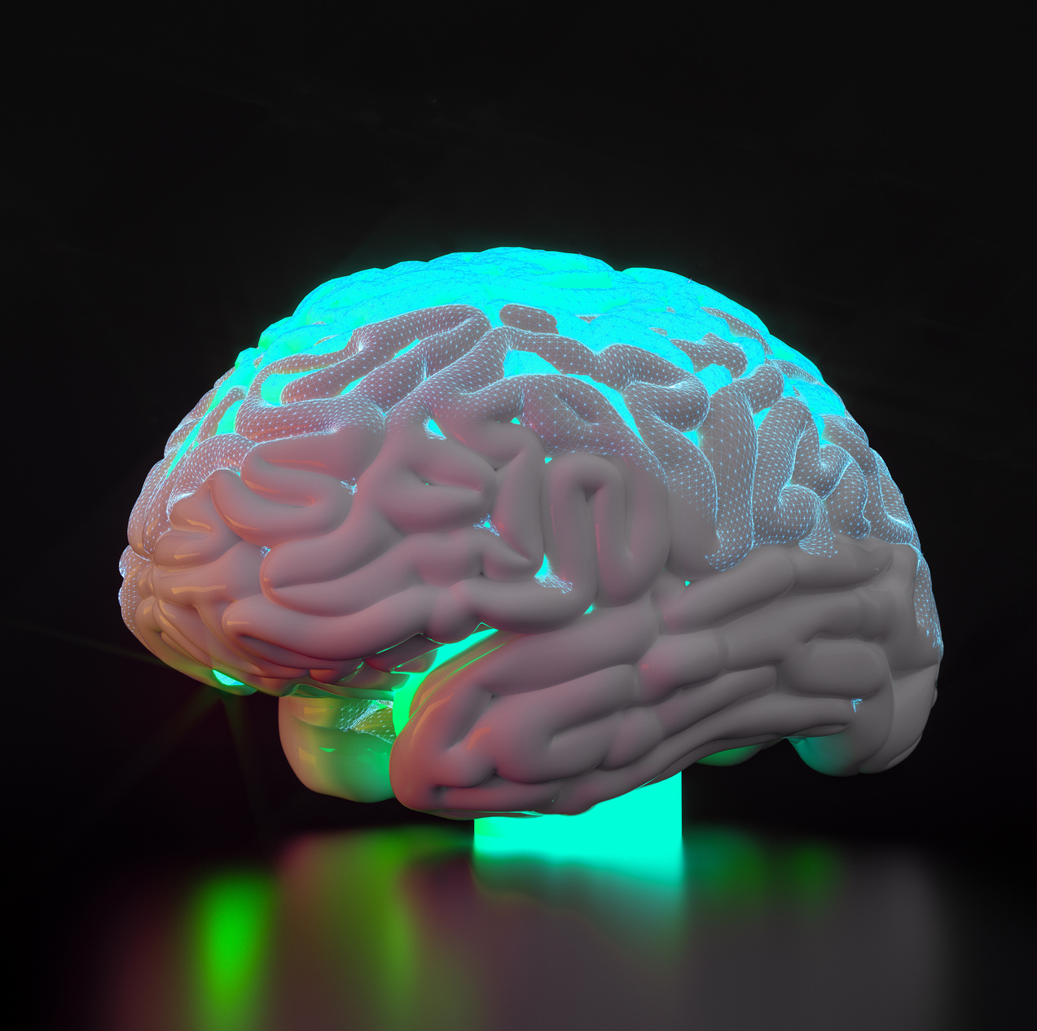
Custom CNN MODEL
Input Layer: Accepts resized images (224×224×3), normalized using Rescaling(1./255)
Convolutional Layers: 3 Conv2D layers with increasing filters (32 → 64 → 128) and ReLU activations
Pooling Layers: Each Conv2D is followed by MaxPooling2D to reduce spatial dimensions
Flattening Layer: Converts 3D feature maps to 1D for fully connected layers
Dense Layer: Fully connected layer with 128 units, ReLU activation, and L2 regularization
Dropout Layer: Dropout(0.6) applied to prevent overfitting
Output Layer: Dense layer with softmax activation to classify into 7 dinosaur species

Slide 8
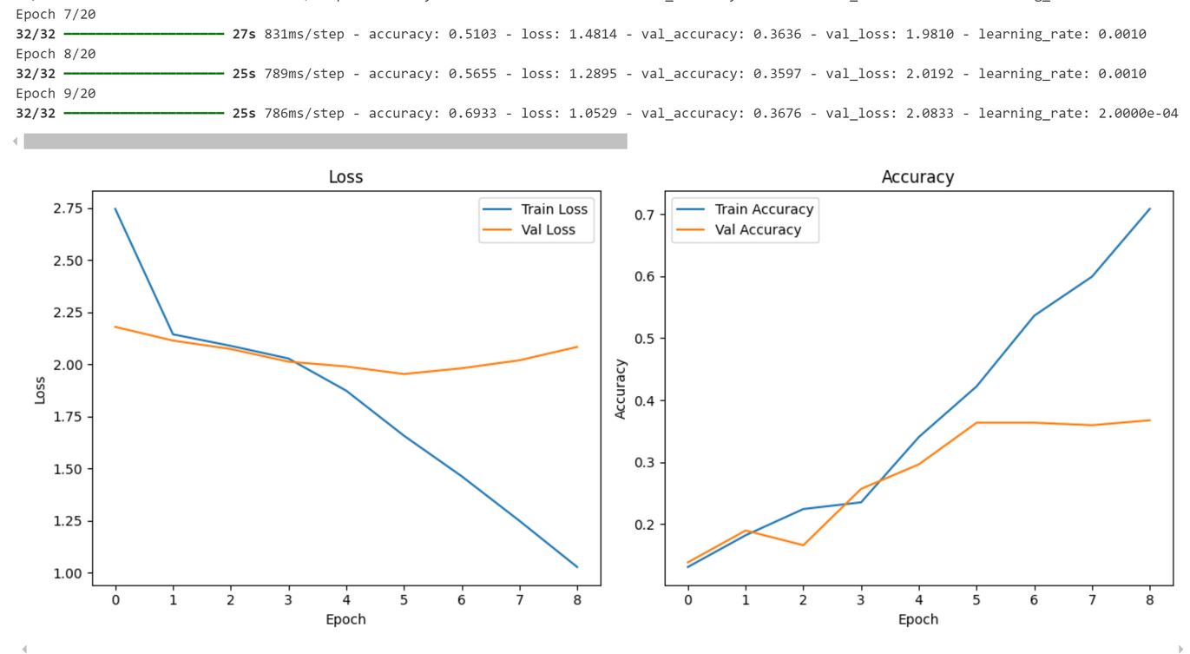
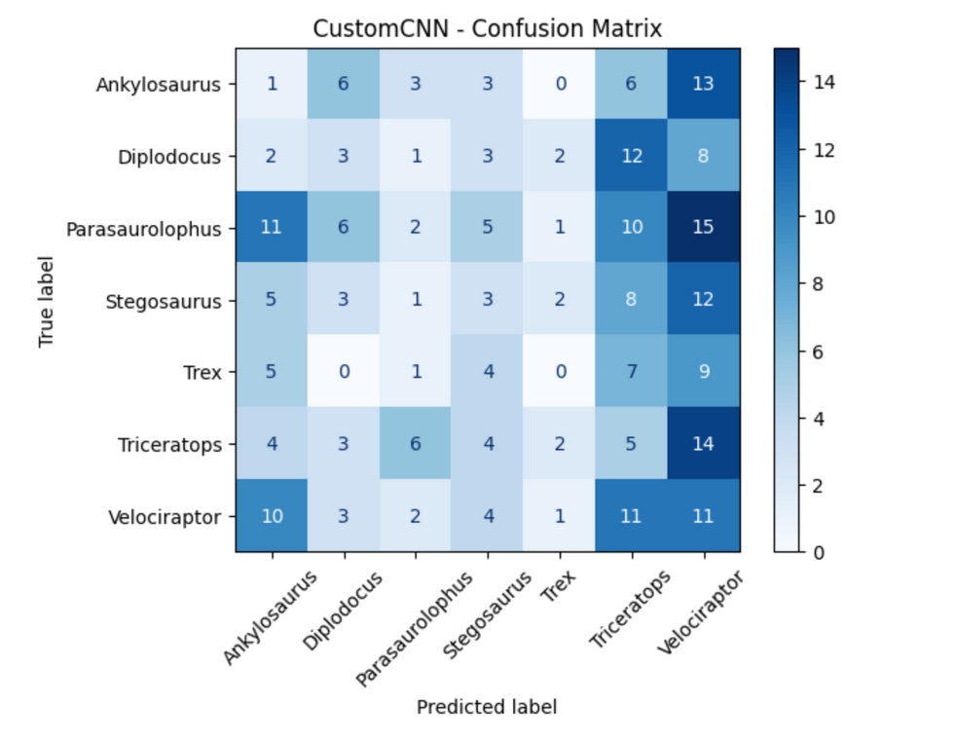
Custom CNN MODEL
Training Loss drops steadily — shows learning from training data.
Validation Loss plateaued and increased slightly — poor generalization.
Training Accuracy reached ~70%.
Validation Accuracy stuck around 36–37% → No improvement after initial epochs.
Overfitting Observed
Heavy confusion between: Parasaurolophus, Triceratops, Velociraptor
Trex class severely misclassified.
Weak diagonal → Model fails to strongly recognize correct classes.

Slide 9

TRANSFER LEARNING
List of pre-trained models used:
EfficientNetB0, B5, B7
MobileNetV2
DenseNet121
ResNet50
Advantages:
Pretrained on ImageNet
Faster convergence
Higher baseline performance

Slide 10
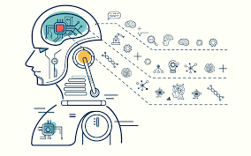
Phase 1 – Feature Extraction
Freeze base model weights
Train classification head only
Function train_and_evaluate_model()
Function generate_kaggle_submission()
tf.keras.backend.clear_session()
Loop through the functions to for each model in our list

Slide 11
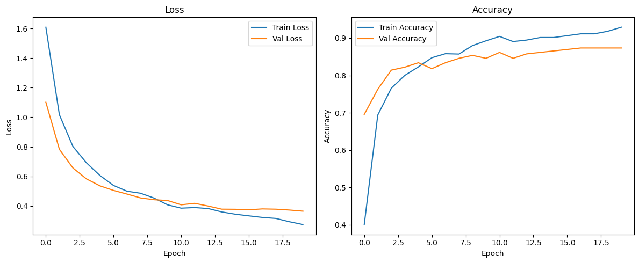
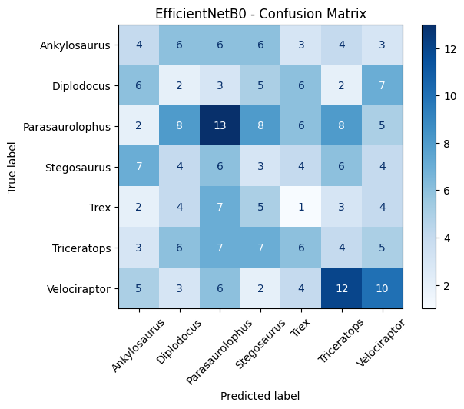
EfficientNetB0 – Results Summary
Loss Curves (Train vs. Validation):
Consistent decrease with smooth convergence
Minimal gap → well-generalized model
Final Validation Loss ≈ 0.36 (low)
Accuracy Curves:
Training Accuracy ≈ 92%
Validation Accuracy ≈ 87%
Close performance → No signs of overfitting.
Confusion Matrix Highlights:
Parasaurolophus: 13 correct predictions
Triceratops & Velociraptor → strong performance
Mild confusion with Trex, Stegosaurus, Ankylosaurus, Diplodocus

Slide 12
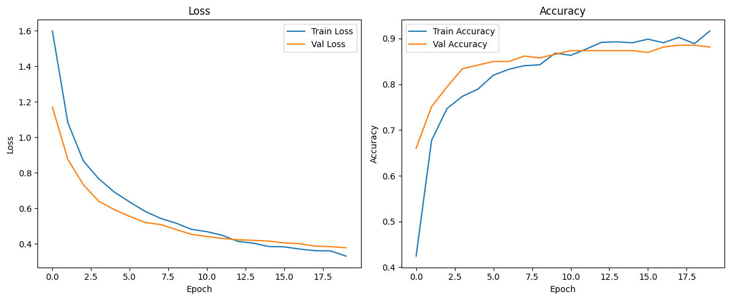
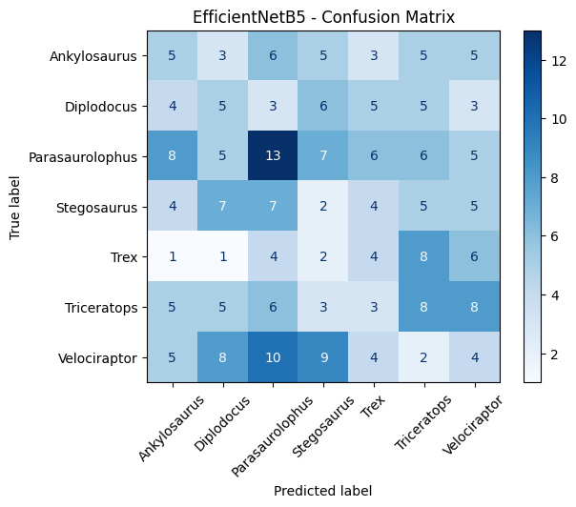
EfficientNetB5 – Results Summary
Loss Curves (Train vs. Validation):
Both curves steadily decrease and converge
Final Validation Loss < 0.38 → stable learning
Smooth, closely aligned curves → strong generalization
Accuracy Curves:
Training Accuracy ≈ 91%
Validation Accuracy ≈ 88.1–88.5%
Close performance → robust, well-generalized model
Confusion Matrix Insights:
Parasaurolophus: 13 correct predictions
Triceratops, Diplodocus, Velociraptor → strong accuracy
Trex misclassified often; mild confusion with similar classes

Slide 13
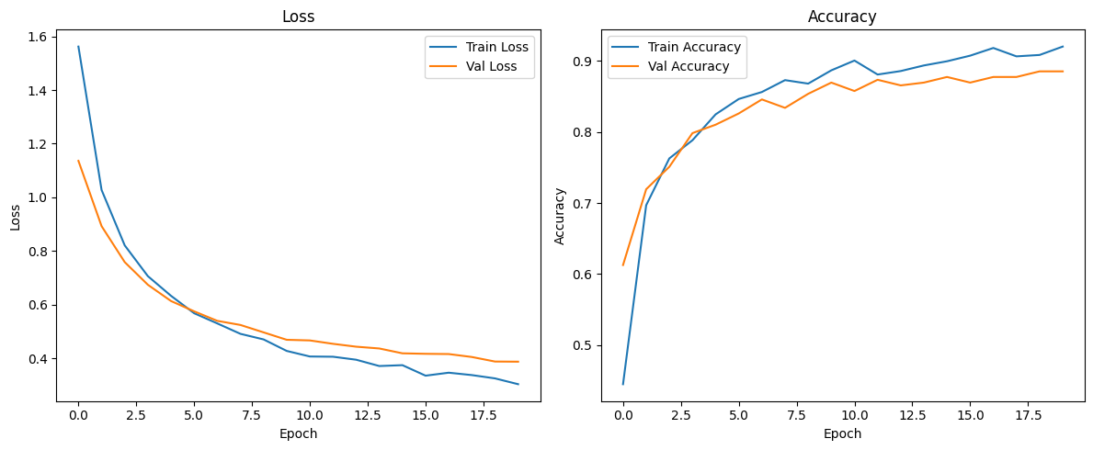
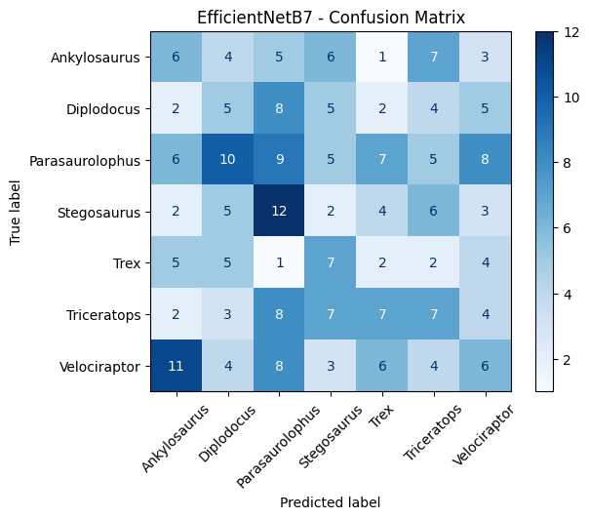
EfficientNetB7 – Results Summary
Loss Curves (Train vs. Validation):
Significant decrease with smooth convergence
Final Validation Loss ≈ 0.38 → stable learning
Minimal gap → no overfitting
Accuracy Curves:
Training Accuracy > 91%
Validation Accuracy ≈ 88.5%
Parallel curves → consistent generalization
Confusion Matrix Insights:
Strong predictions: Stegosaurus (12), Parasaurolophus (10), Diplodocus (8)
Confusion: Trex, Velociraptor, Triceratops show scattered predictions
Overall: Diagonal trend intact → consistent model confidence

Slide 14
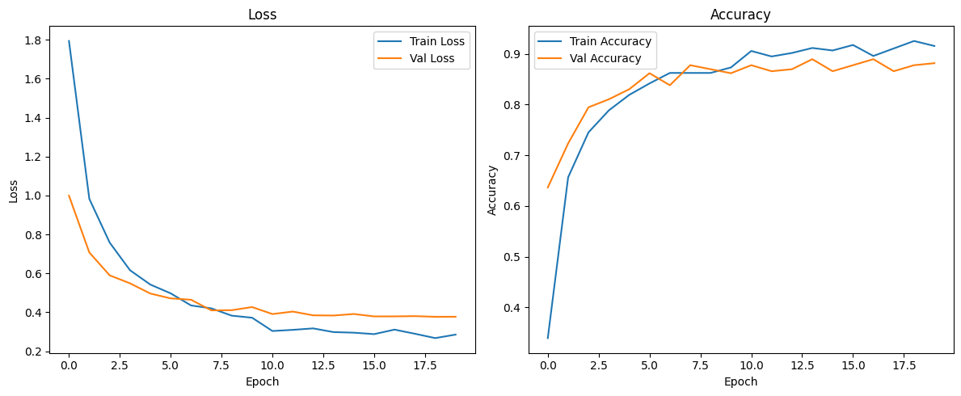
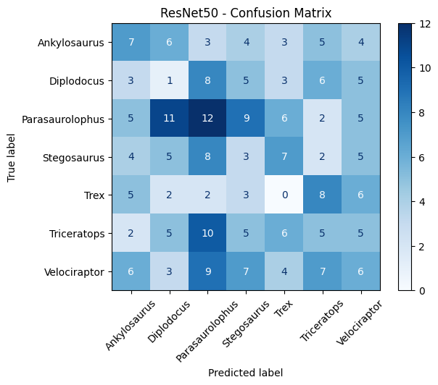
ResNet50 – Results Summary
Loss Curves (Train vs. Validation):
Training loss steadily decreases over 20 epochs
Validation loss closely follows → strong generalization
Accuracy Curves:
Training Accuracy > 92%
Validation Accuracy ≈ 88.1%
Stable curves → no overfitting
Confusion Matrix Insights:
Minor confusion: Diplodocus vs. Parasaurolophus, Trex vs. Triceratops, Stegosaurus vs. Parasaurolophus
Most predictions on diagonal → high classification accuracy

Slide 15
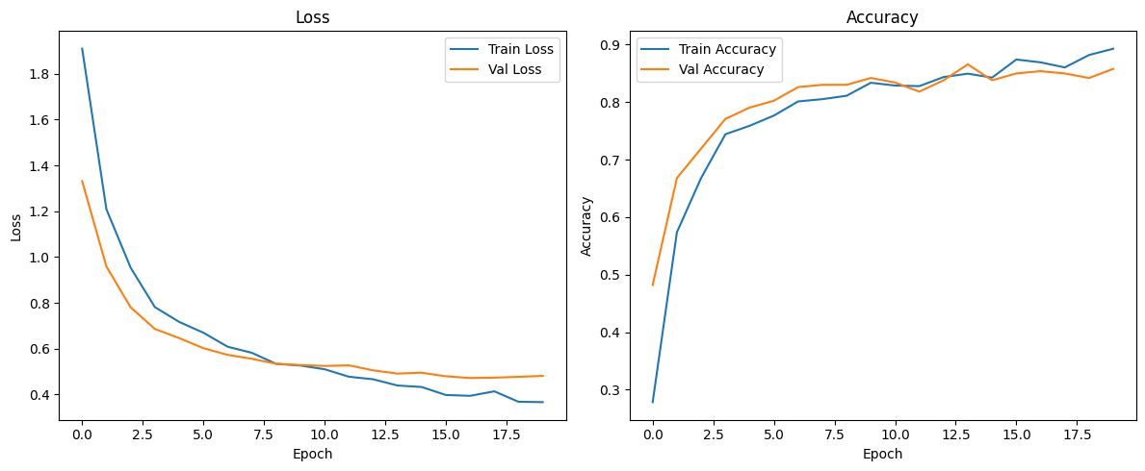
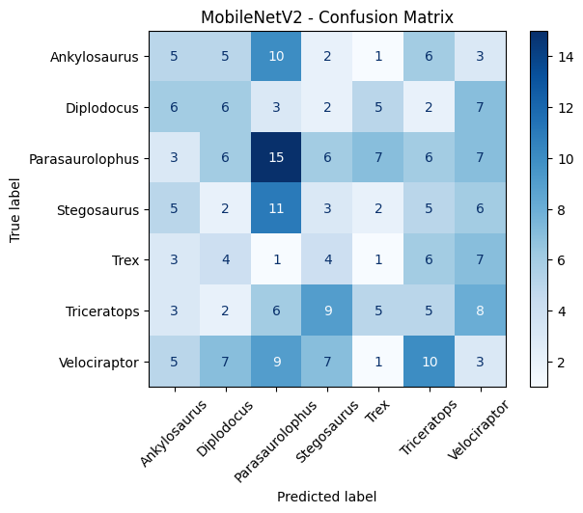
MobileNetV2 – Results Summary
Loss Curves (Train vs. Validation):
Steady decrease with closely tracking curves
Final loss stabilizes → convergence without overfitting
Accuracy Curves:
Training Accuracy ≈ 90%
Validation Accuracy ≈ 85–86%
Training and validation accuracies track closely throughout
Confusion Matrix Insights:
Strong predictions: Parasaurolophus, Stegosaurus
Confusion: Ankylosaurus ↔ Diplodocus; Velociraptor vs. others
Overall diagonal dominance → generally accurate classifications

Slide 16
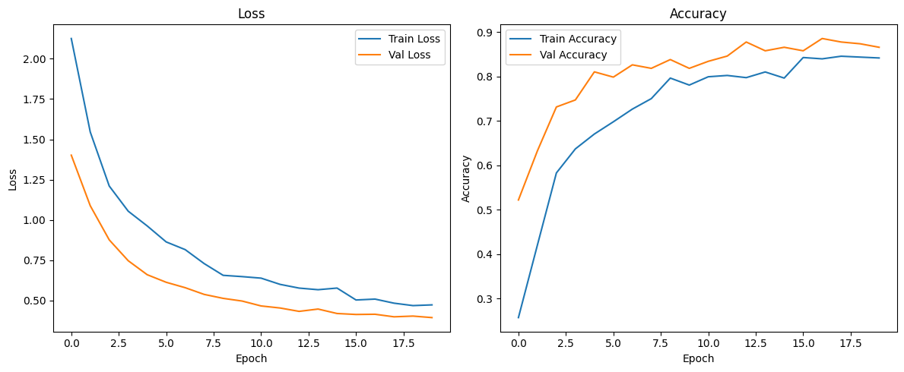
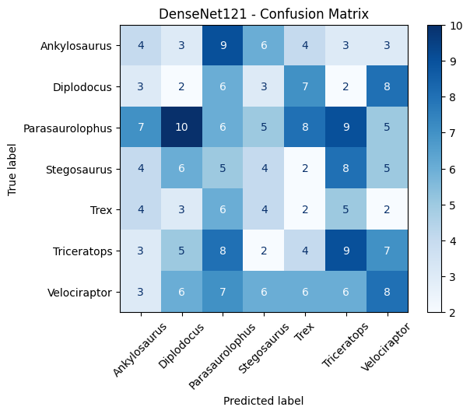
DenseNet121 – Results Summary
Loss Curves (Train vs. Validation):
Both losses decrease steadily and converge
Smooth curves → no overfitting or underfitting
Accuracy Curves:
Training Accuracy ≈ 85.4%
Validation Accuracy ≈ 87.6%
Noticeable gap → moderate overfitting
Confusion Matrix Insights:
Minor confusion: Ankylosaurus ↔ Parasaurolophus, Diplodocus ↔ Triceratops, Trex scattered
Strong diagonal dominance → most samples correctly classified

Slide 17

Phase 2 – Fine-Tuning
Enable fine‑tuning (fine_tune=True, fine_tune_at=100)
Unfreeze top base layers (freeze first 100 layers)
Train both classification head and unfrozen base layers
Function train_and_evaluate_model()
Function generate_kaggle_submission() → outputs *_finetuned.csv
tf.keras.backend.clear_session()
Loop through each model in models_to_test for fine‑tuning

Slide 18
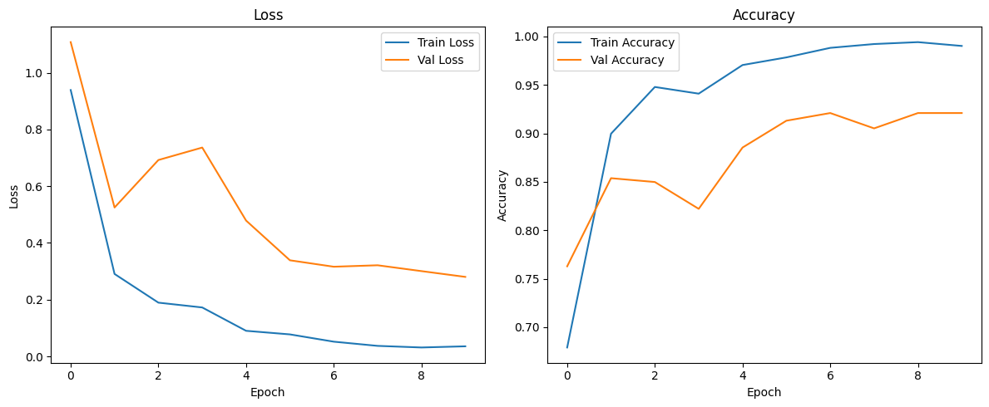
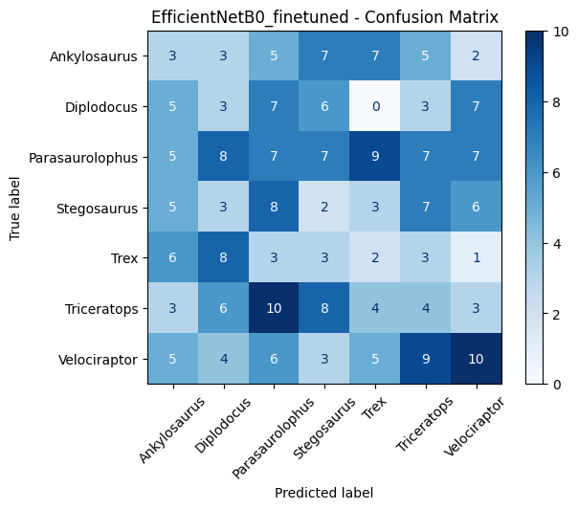
Fine‑Tuned EfficientNetB0 – Results Summary
Loss Curves (Train vs. Validation):
Training loss drops near zero
Validation loss decreases then fluctuates → slight overfitting
Accuracy Curves:
Training Accuracy ≈ 99%
Validation Accuracy ≈ 92%
Noticeable gap → moderate overfitting
Confusion Matrix Insights:
Strong diagonal across most classes
Remaining confusion: Triceratops ↔ Stegosaurus; Velociraptor ↔ Parasaurolophus; Trex ↔ Diplodocus
Overall Performance:
Fine-tuning boosts accuracy over baseline
Consider additional regularization or less aggressive tuning to improve generalization

Slide 19
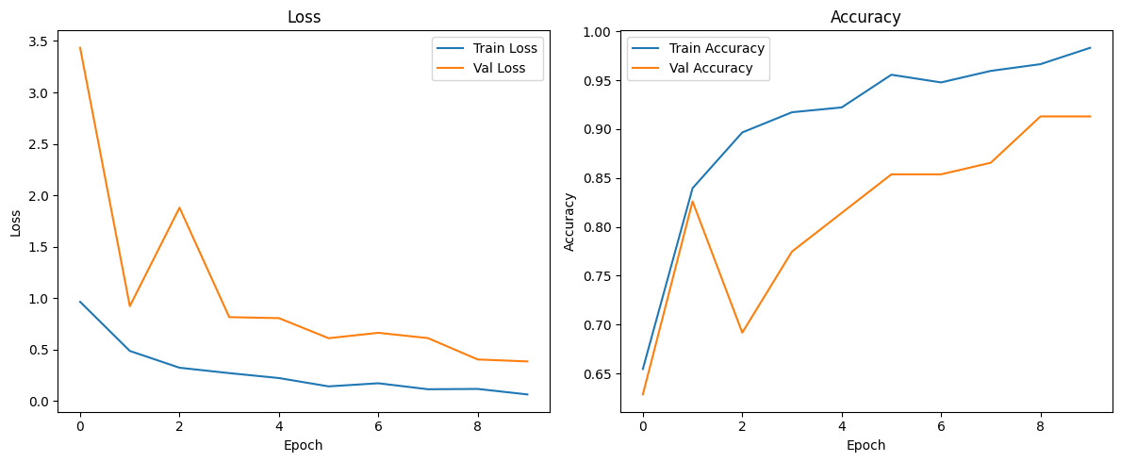
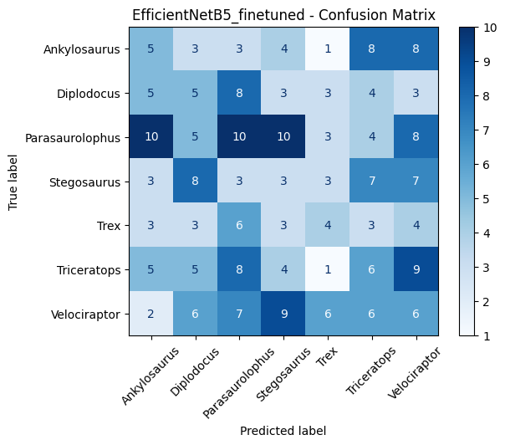
Fine‑Tuned EfficientNetB0 – Results Summary
Loss Curves (Train vs. Validation):
Smooth, continuous training loss decline
Validation loss fluctuates early then stabilizes and decreases.
Accuracy Curves:
Training Accuracy ≈ 99%
Validation Accuracy ≈ 92%
Curves track closely → no overfitting
Confusion Matrix Insights:
Strong classification across all classes
Parasaurolophus: 10 correct
Triceratops & Velociraptor also high
Minor, evenly distributed off‑diagonal errors.

Slide 20
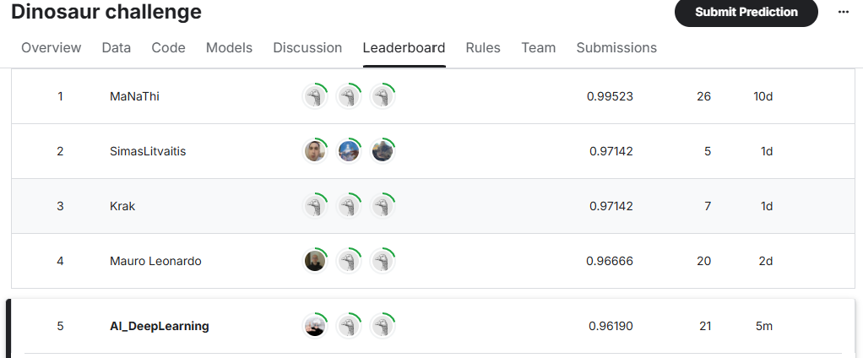
Kaggel Submission

Slide 21

Thank
You
For All Your Attention

